Slide 1

WINNING CAMP
Name – Paritosh Singh
UID – 21MCA2149
Section – MCA-11

Slide 2
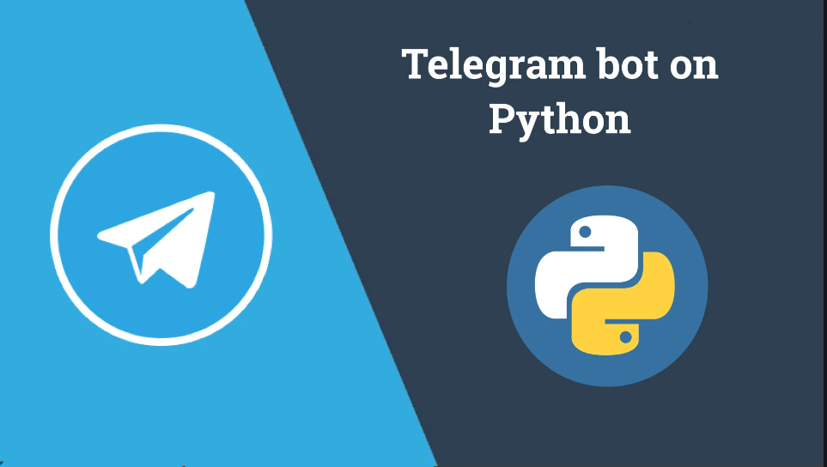

Slide 3

What Are Bots
A bot -- short for robot and also called an internet bot -- is a computer program that operates as an agent for a user or other program or to simulate a human activity. Bots are normally used to automate certain tasks, meaning they can run without specific instructions from humans.

Slide 4
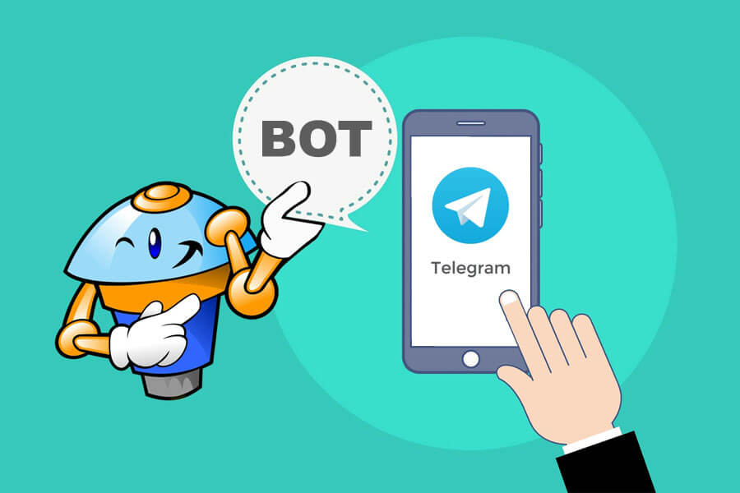
Why we use Bots
Bots are lot easier to access than searching on internet.
We can also interact with bots.
We can automate the repetitive process by using bots.
It saves time and also requires less bandwidth.

Slide 5


Technologies Used
Telegram App - Telegram is the fastest messaging app on the market, connecting people via a unique, distributed network of data centers around the globe.
Python – It is a widely used language. I have choose this language because it has large support of the different libraries which we can use later on the project.

Slide 6

BotFather
BotFather is the one bot to rule them all. Use it to create new bot accounts and manage your existing bots. Send Message. If you have Telegram, you can contact BotFather right away.

Slide 7
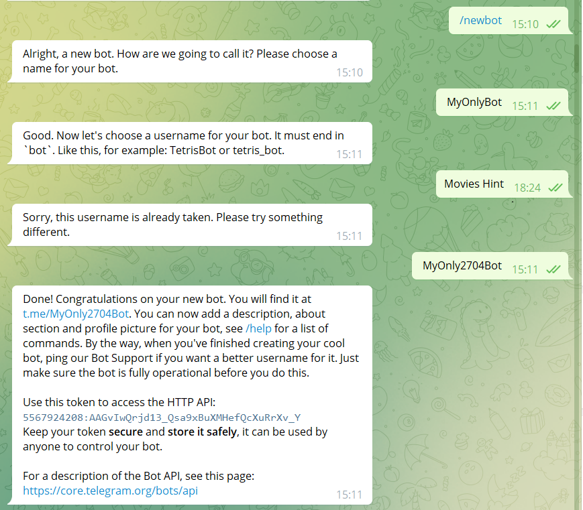
Steps to create Telegram Bot
Start a new conversation with the BotFather.
Send /newbot to create a new Telegram bot.
When asked, enter a name for the bot.
Give the Telegram bot a unique username.
Copy and save the Telegram bot's access token for later steps.

Slide 8
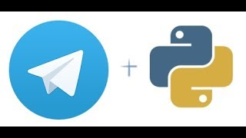
Integrate Python with Telegram Bot
Installation of Module
python-telegram-bot module
This library provides a pure Python interface for the Telegram Bot API. this library features a number of high-level classes to make the development of bots easy and straightforward. These classes are contained in the “telegram.ext” submodule.
pip install python-telegram-bot

Slide 9
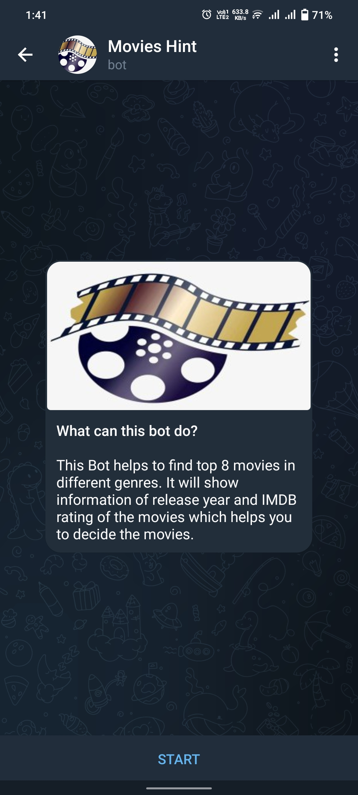
MOVIES HINT
This Telegram bot gives the suggestion to the user about the top 8 movies he can get in different genres like Action, Sci-fi, Fantasy etc.
It also provides the IMDB rating of the movies so that user can decide what movies he can watch.
It also provides the link of the top 50 movies in IMDB according to the genres.

Slide 10
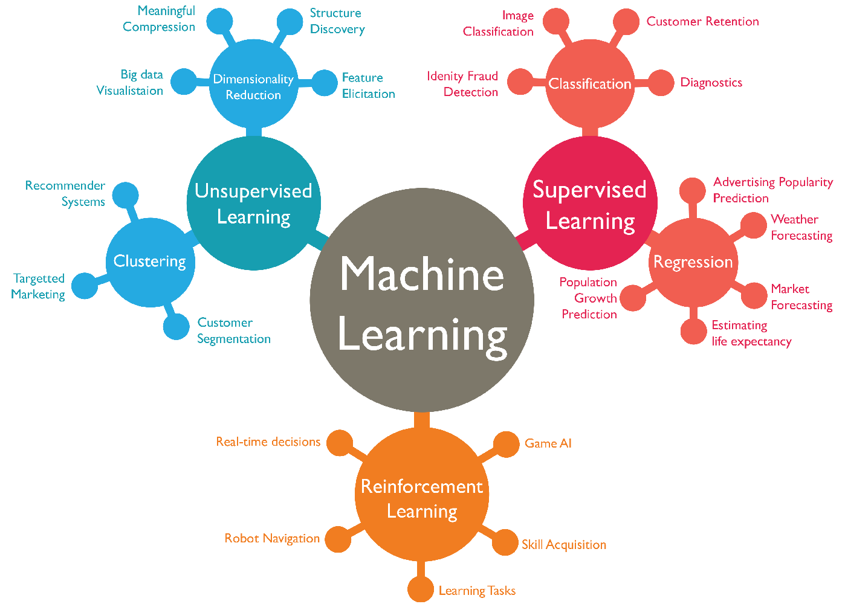
SCOPE
In future , we can implement the movie search engine in which the user can search for specific movie and get the movie full details.
We can also implement the machine learning which helps the bot for the more user interaction.
When new movies get released it can also update the list of movies automatically.

Slide 11
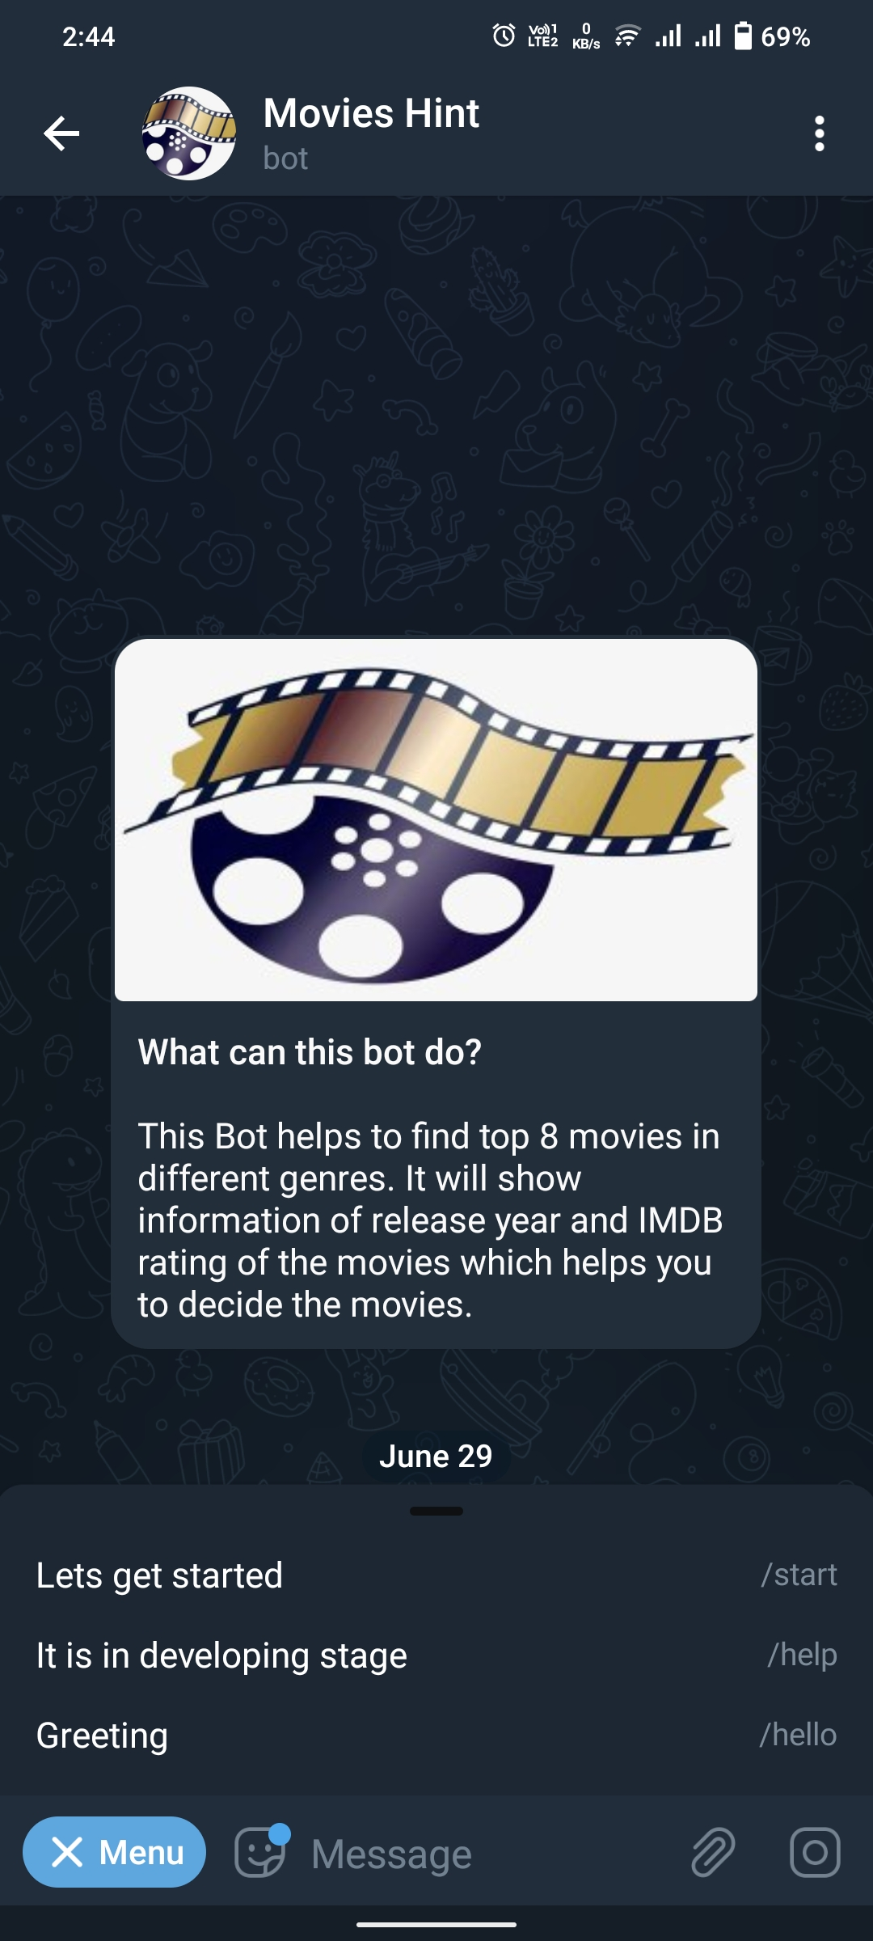
Working Modules
I have Implemented 3 basic commands in my telegram bot.
\start – It starts the bot.
\help – It is in developing stage
\hello – It greets the users

Slide 12
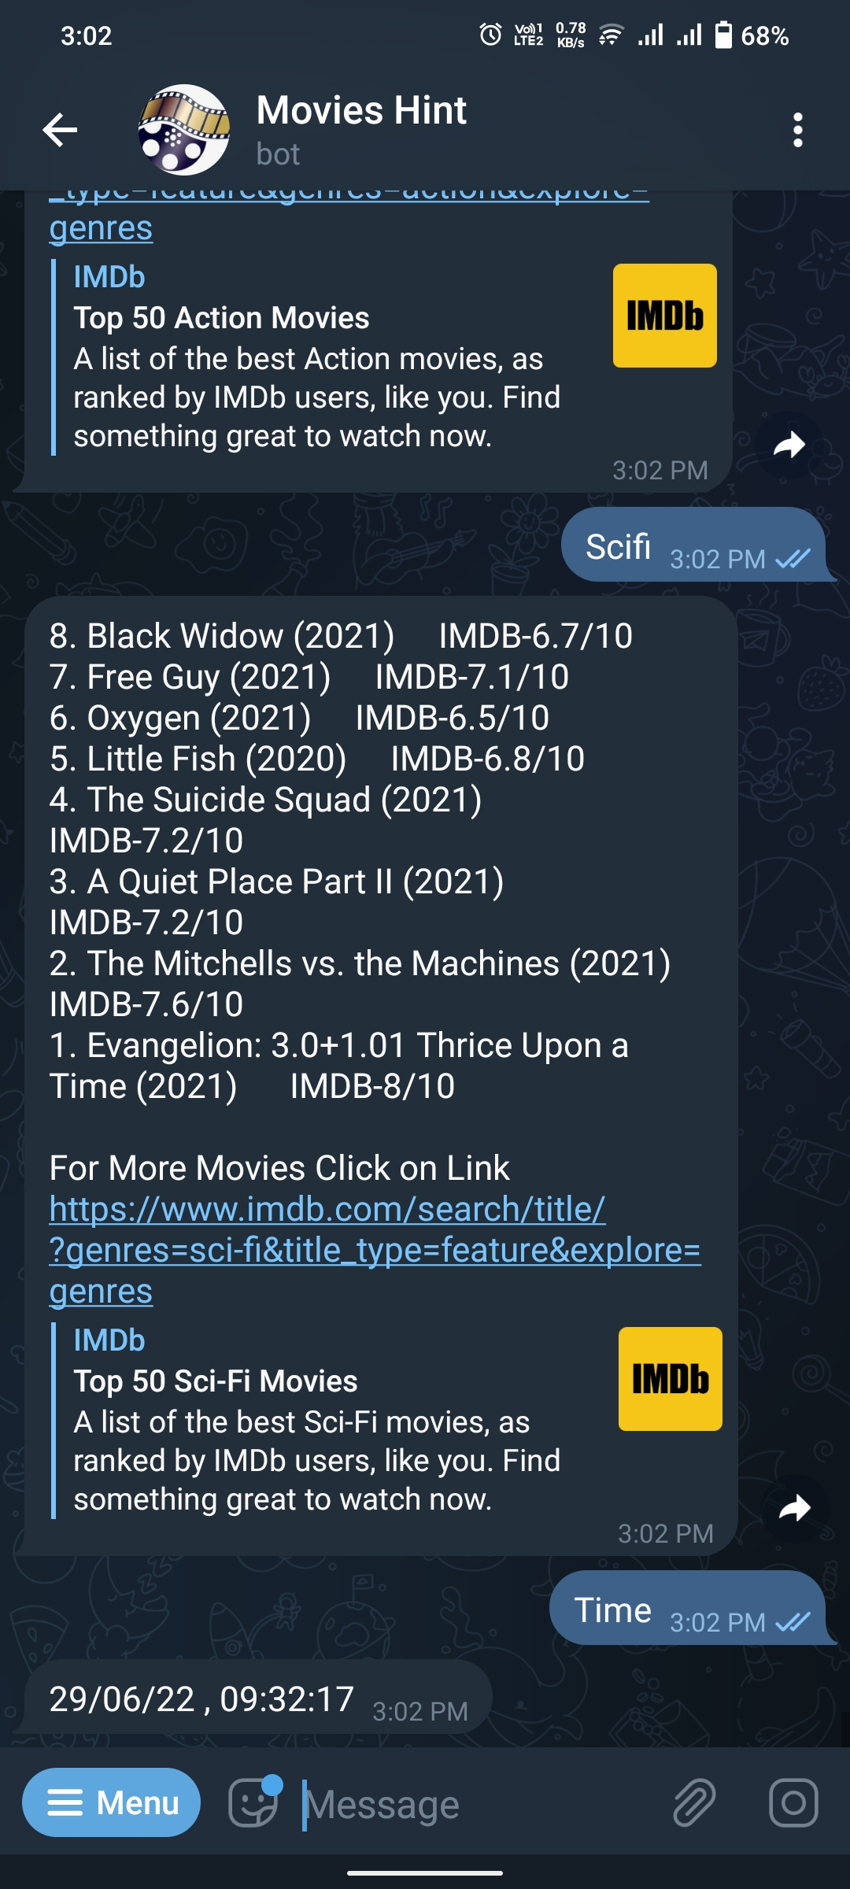
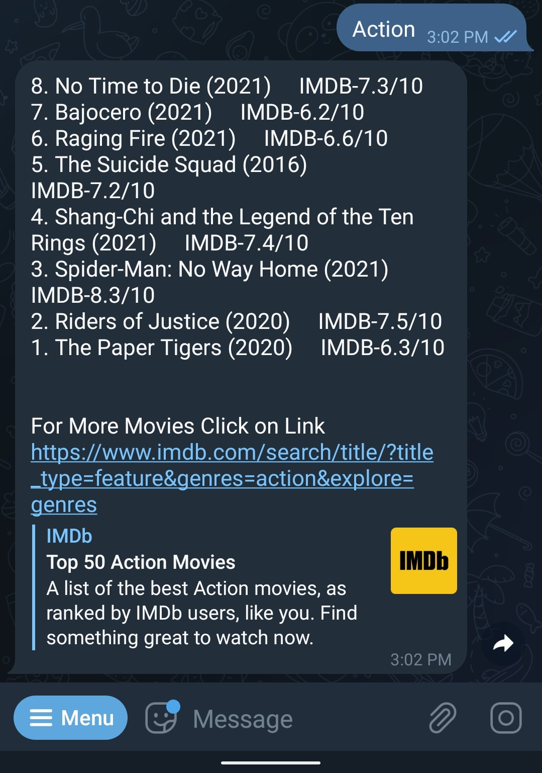
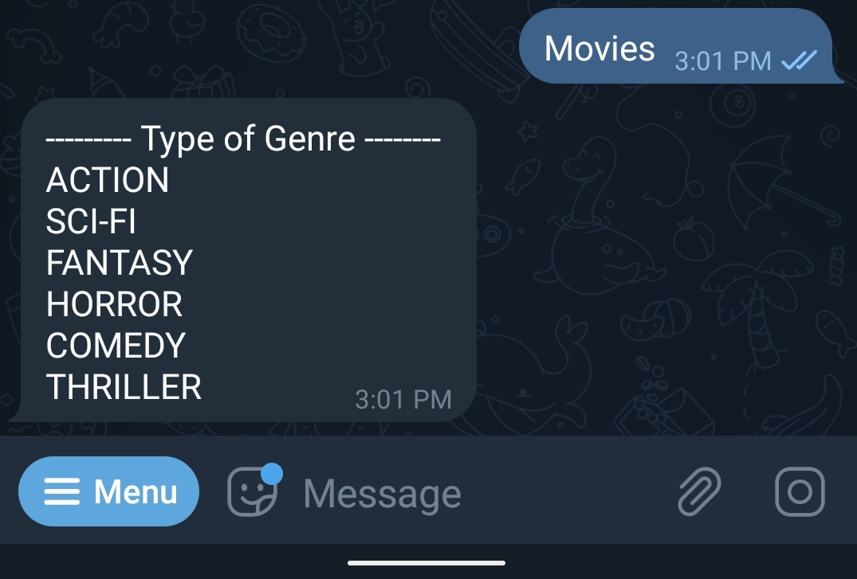
Responses
These are responses we get from the bot by typing specific keywords.
Some of the keywords are – movies, action, fantasy, scifi, genre etc.

Slide 13
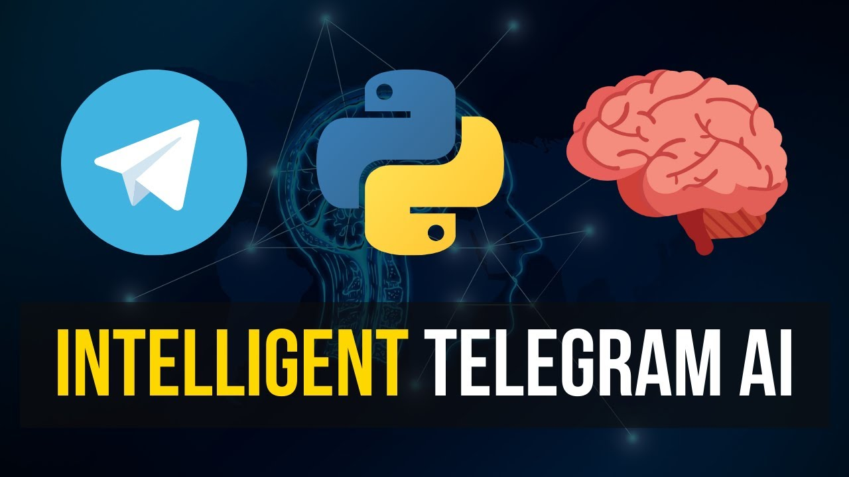
FUTURE ASPECTS
In future , we can gather user information and analyze according to the user behavior and preferences.
We can also integrate the use of artificial intelligence which helps in better working of the bot.

Slide 14


